Slide 1
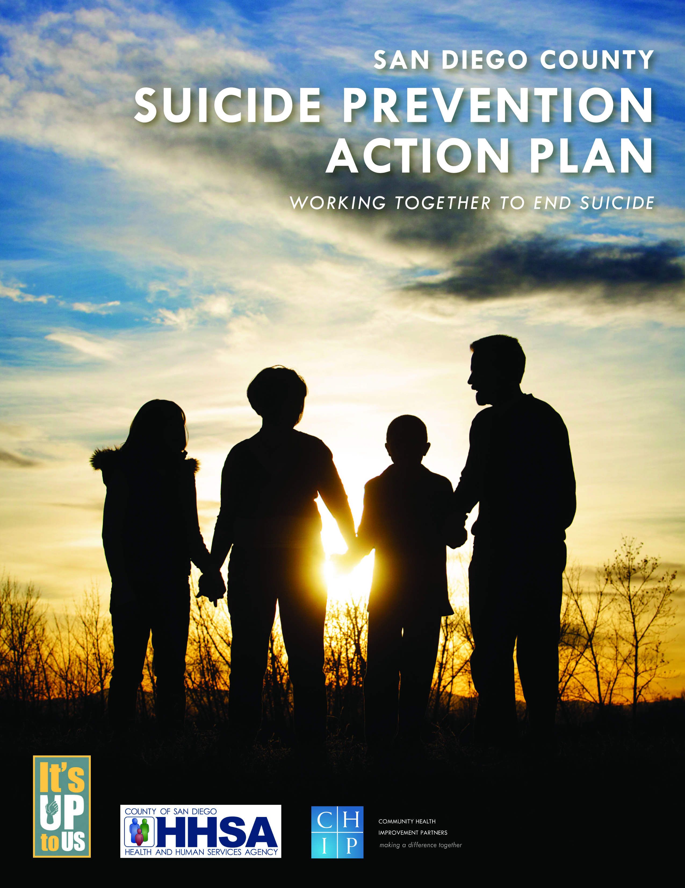
San Diego County Suicide Prevention Council (SPC) Working Together to End Suicide
OCTOBER 2011
2013

Slide 2
Agenda
Background
Development of the
SPAP
Process
Strategy Organization
Suicide Prevention Council
Mission, Vision, Core Values
Implementation (Strategic Plan)

Slide 3
Background
Every 16 minutes
One per Day
11 TO 1
Six-fold increase
Notes:
Every 16 minutes someone in the US dies by suicide
One suicide per day in San Diego County
Estimated: 11 suicide attempts for every one suicide death
Alcohol and drug abuse disorders lead to a six fold increase in the risk of suicide attempts
“The paper underscores the need for people in the mental health field to be aware of substance abuse issues and co-occurring disorders as well as for substance abuse professionals to be aware of the risk of suicide,” said Dr. McKeon. “There needs to be increased collaboration.”
a growing body of evidence suggests that alcohol and drug abuse are second only to depression and other mood disorders when it comes to risk factors for suicide. In one study, for example, alcohol and drug abuse disorders were associated with a six-fold increase in the risk of suicide attempts. And substance abuse and mental disorders often go hand-in-hand, the paper emphasizes.
http://www.samhsa.gov/samhsanewsletter/Volume_17_Number_1/SubstanceAbuseAndSuicide.aspx

Slide 4
Development of the SPAP - Process

Slide 5
SPAP Needs Assessment - Key Target Populations
Lesbian, Gay, Bisexual, Transgender (LGBT);
Native American;
Latino;
Older Adults - ages 65 years and older;
Asian/Pacific Islander (API);
Transitional Age Youth (TAY) ages 18-24 years.

Slide 6
SPAP Needs Assessment - High Risk Populations
Veterans;
Middle aged men;
Older adults (65+);
Recently divorced or
separated;
History of:
Substance abuse;
Sexual abuse;
Previous suicide attempt;
Suicide in family;
Chronic mental health disorder;
Co-occurring disorders.

Slide 7
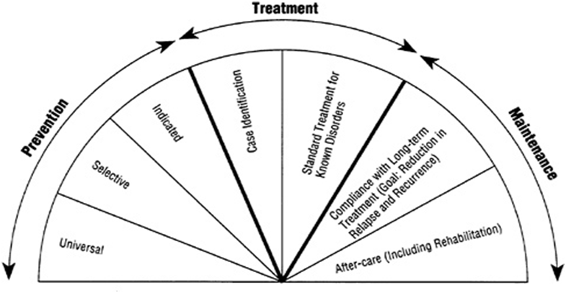
Development of the SPAP - Spectrum of Interventions
Notes:
The spectrum of interventions proposed by the Institute for Medicine and highlighted in the California Strategic Plan¹⁸ formed the framework for organizing community and stakeholder input related to prevention strategies (Exhibit 2 on page 5). These interventions include all areas of intervention for mental health disorders. By design, the suicide prevention action planning process focused on the three elements of prevention: universal, selective, and indicated strategies.
Universal strategies are targeted to the general public or a whole population group. Designed to influence everyone, they reduce suicide risk by strengthening protective factors like community support and social skills, removing barriers to care, enhancing knowledge of what to do to help suicidal individuals, and increase access to help. Examples of interventions include public education campaigns, “suicide awareness” programs, education programs for the media on reporting practices related to suicide, and crisis response plans and teams.
¨ Selective strategies focus on at-risk groups that have a greater probability of becoming suicidal and aim to prevent the onset of suicidal behaviors among specific subpopulations. This level of prevention includes screening programs, gatekeeper training for “frontline” adult caregivers and peer “natural helpers,” support and skill building groups for at-risk groups in the population, and enhanced accessible crisis services and referral sources.
¨ Indicated strategies target high-risk individuals that exhibit early signs of suicide potential. Programs are designed and delivered in groups or individually to reduce risk factors and increase protective factors. At this level, programs include skill-building support groups, case management for individual high-risk individuals, and referral sources for crisis intervention and treatment.

Slide 8
Development of the SPAP - Spectrum of Interventions
Universal Strategies
Target the general public & designed to influence everyone.
Reduce suicide risk by:
strengthening protective factors;
removing barriers;
enhancing knowledge;
increasing access to help.
Notes:
¨ Universal strategies are targeted to the general public or a whole population group. Designed to influence everyone, they reduce suicide risk by strengthening protective factors like community support and social skills, removing barriers to care, enhancing knowledge of what to do to help suicidal individuals, and increase access to help. Examples of interventions include public education campaigns, “suicide awareness” programs, education programs for the media on reporting practices related to suicide, and crisis response plans and teams.
¨ Selective strategies focus on at-risk groups that have a greater probability of becoming suicidal and aim to prevent the onset of suicidal behaviors among specific subpopulations. This level of prevention includes screening programs, gatekeeper training for “frontline” adult caregivers and peer “natural helpers,” support and skill building groups for at-risk groups in the population, and enhanced accessible crisis services and referral sources.
¨ Indicated strategies target high-risk individuals that exhibit early signs of suicide potential. Programs are designed and delivered in groups or individually to reduce risk factors and increase protective factors. At this level, programs include skill-building support groups, case management for individual high-risk individuals, and referral sources for crisis intervention and treatment.

Slide 9
Development of the SPAP - Spectrum of Interventions
Selective Strategies
Focus on at-risk groups with a greater probability of becoming suicidal.
Reduce suicide risk by preventing the onset of suicidal behaviors among specific subpopulations.
Notes:
¨ Universal strategies are targeted to the general public or a whole population group. Designed to influence everyone, they reduce suicide risk by strengthening protective factors like community support and social skills, removing barriers to care, enhancing knowledge of what to do to help suicidal individuals, and increase access to help. Examples of interventions include public education campaigns, “suicide awareness” programs, education programs for the media on reporting practices related to suicide, and crisis response plans and teams.
¨ Selective strategies focus on at-risk groups that have a greater probability of becoming suicidal and aim to prevent the onset of suicidal behaviors among specific subpopulations. This level of prevention includes screening programs, gatekeeper training for “frontline” adult caregivers and peer “natural helpers,” support and skill building groups for at-risk groups in the population, and enhanced accessible crisis services and referral sources.
¨ Indicated strategies target high-risk individuals that exhibit early signs of suicide potential. Programs are designed and delivered in groups or individually to reduce risk factors and increase protective factors. At this level, programs include skill-building support groups, case management for individual high-risk individuals, and referral sources for crisis intervention and treatment.

Slide 10
Development of the SPAP - Spectrum of Interventions
Indicated Strategies
Target high-risk individuals exhibiting early signs of suicide potential.
Programs are designed & delivered in groups or individually to reduce risk factors & increase protective factors.
Notes:
¨ Universal strategies are targeted to the general public or a whole population group. Designed to influence everyone, they reduce suicide risk by strengthening protective factors like community support and social skills, removing barriers to care, enhancing knowledge of what to do to help suicidal individuals, and increase access to help. Examples of interventions include public education campaigns, “suicide awareness” programs, education programs for the media on reporting practices related to suicide, and crisis response plans and teams.
¨ Selective strategies focus on at-risk groups that have a greater probability of becoming suicidal and aim to prevent the onset of suicidal behaviors among specific subpopulations. This level of prevention includes screening programs, gatekeeper training for “frontline” adult caregivers and peer “natural helpers,” support and skill building groups for at-risk groups in the population, and enhanced accessible crisis services and referral sources.
¨ Indicated strategies target high-risk individuals that exhibit early signs of suicide potential. Programs are designed and delivered in groups or individually to reduce risk factors and increase protective factors. At this level, programs include skill-building support groups, case management for individual high-risk individuals, and referral sources for crisis intervention and treatment.

Slide 11
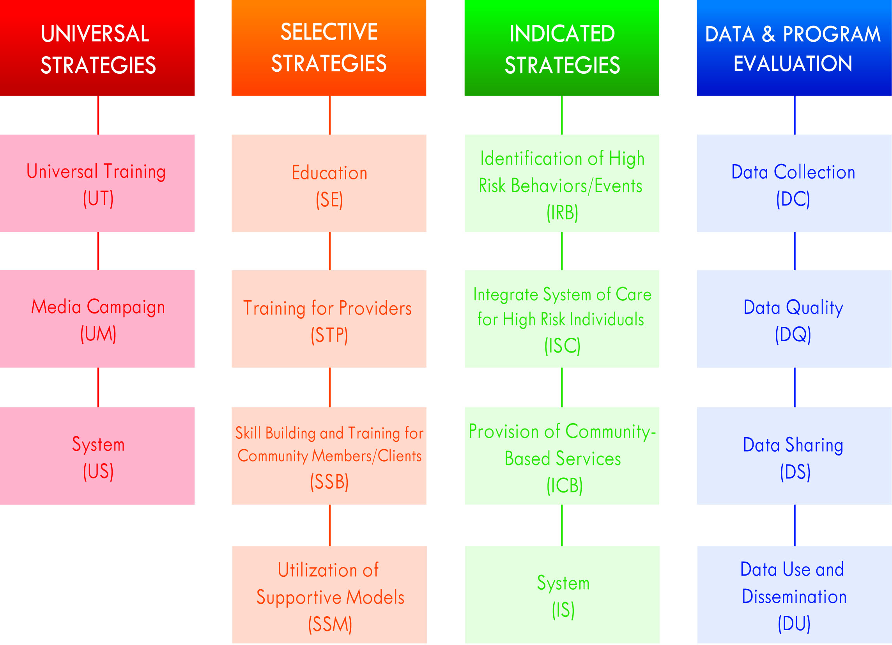
Development of the SPAP - Strategy Organization
Notes:
Meetings with community members and stakeholders to discuss each prevention focus area took place from January 2011 through June 2011. During these six months, five SPAPC meetings and six subcommittee meetings were convened to achieve the following:
¨ Subcommittee Meetings: Identify universal, selective and indicated suicide prevention strategies
¨ SPAPC Meetings: Review and update progress on the planning process, discuss suicide prevention strategies identified in subcommittees, and address any emerging key areas of concern.
Subcommittee meetings addressed details related to the following four components: 1) suggested focus area actions; 2) cultural considerations, 3) service considerations, and 4) promising/best practices.
ASK: Hands to show groups that work in each of the three strategy areas.

Slide 12
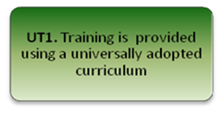
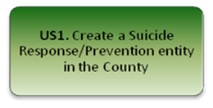
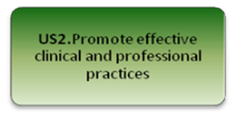
Universal Strategies Priority Objectives

Slide 13
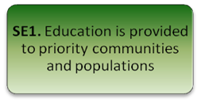
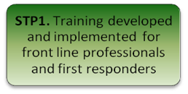
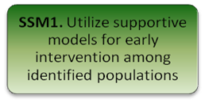
Selective Strategies Priority Objectives
￼￼￼

Slide 14
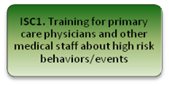
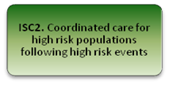
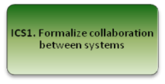
Indicated Strategies Priority Objectives

Slide 15
Suicide Prevention Council –
Vision, Mission, Goals
Vision: Zero suicides in San Diego County
Mission: To prevent suicide and its devastating consequences in San Diego County
This can best be accomplished through….
Enhancing collaborations to promote a suicide-free community
Conducting needs assessments to identify gaps in suicide prevention services and supports
Disseminating vital information on the signs of suicide and effective help-seeking
Providing resources to those affected by suicide and suicidal behavior
Advancing policies and practices that contribute to the prevention of suicide

Slide 16
Suicide Prevention Council –
Core Values
Core Values
The Suicide Prevention Council believes that these core values best support suicide prevention in San Diego County:
A public health approach to prevention
Collaboration and non-competitive partnerships
Evidenced-based practices
Cultural and linguistic sensitivity
Coordinated and accessible services
Support for individuals, families, and communities

Slide 17
Suicide Prevention Council –
Strategic Plan
3-year SPC strategic plan
Implementation of SPAP recommendations
Driven by community
“Roadmap” for SPC activities
Complement partners’ current work
Over a 3 month period,
developed:
Goals & objectives
Activities
Timeline & lead partners

Slide 18
Suicide Prevention Council –
Strategic Plan Sample
Goal #2: Conduct assessment to identify gaps in suicide prevention services and supports.
Objective 2.3: Identify high risk groups that do not currently have suicide risk assessment procedures.
Activity 2.3a: Assess current procedures in place by front line providers, including primary care providers, ED staff, first responders (EMT, paramedic, firefighters), community based providers.
Notes:
Goal #2: Conduct assessment to identify gaps in suicide prevention services and supports: This goal address recommendations to continually track, assess, and report on suicides, suicidal behaviors, and suicide prevention efforts in San Diego County.

Slide 19
Suicide Prevention Council –
Strategic Plan Sample
Goal #3: Disseminate vital information on the signs of suicide and effective help-seeking.
Objective 3.2: Increase the availability of suicide prevention, intervention, and postvention materials
Activity 3.2e: Create a “first responder” tool-kit for suicide prevention, intervention, and postvention.
Notes:
Goal #2: Conduct assessment to identify gaps in suicide prevention services and supports: This goal address recommendations to continually track, assess, and report on suicides, suicidal behaviors, and suicide prevention efforts in San Diego County.

Slide 20
Suicide Prevention Council –
Strategic Plan Sample
Goal #4: Provide resources to those affected by suicide and suicidal behavior.
Objective 4.1: Increase the number of physicians and other community service providers who are knowledgeable about suicide prevention, intervention, and postvention resources.
Activity 4.1c: Provide resources and training to groups identified in 2.3a.
Notes:
Goal #2: Conduct assessment to identify gaps in suicide prevention services and supports: This goal address recommendations to continually track, assess, and report on suicides, suicidal behaviors, and suicide prevention efforts in San Diego County.

Slide 21
Questions?
SPC Monthly Meeting:
Fourth Tuesday of every month
10:00 – 11:30am
HHSA Rosecrans – Coronado Room
3851 Rosecrans Street
San Diego CA
Yeni L. Palomino
Program Manager
Community Health Improvement Partners (CHIP)
(858) 609-7969
ypalomino@sdchip.org
Notes:
Questions to ask at meeting:
How can you (ADS PEI) become more involved?
What can we (SPC) do to help you in your efforts?

